Slide 1
Impetus Technologies Inc.
User Story Specific
Code Coverage Tool
(USSCC Tool)

Slide 2
Agenda
Problem Statement
Solution and Benefits
How it works
Tools Capability
Screenshots

Slide 3
Problem Statement
Legacy products in most of the cases have quite less code coverage.
We deliver new code in Sprints as User stories, on top of legacy code, but..
There are no tools available that give code coverage specific to User stories.

Slide 4
Solution and Benefits
USSCC Tool calculates code coverage specific to the user stories we deliver.
This give clear picture in terms of percentage of code coverage for each user story.
And hence coverage result does not get diluted with usually low legacy code coverage or other user stories coverage.

Slide 5
How it works
Tool is available as a Plugin to SonarQube.
Add it as widget to Dashboard.
At start of sprint, configure plugin with list of user stories in sprint scope.
Generate sonar report for your project.
See Coverage Result on SonarQube Dashboard.

Slide 6
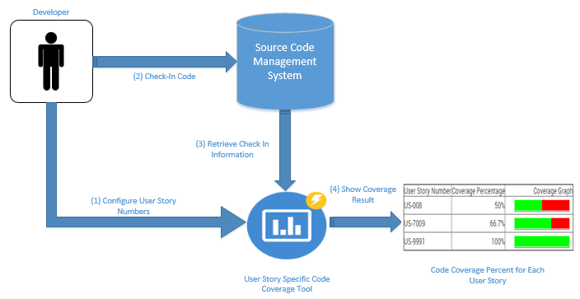
How it works

Slide 7
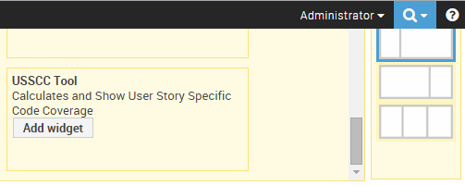
USSCC Plugin – Add to SonarQube Dashboard

Slide 8
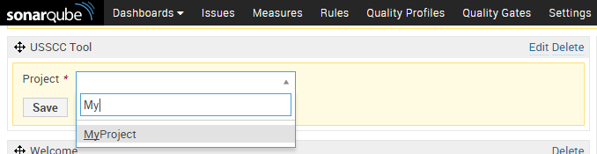
USSCC Plugin – Add to SonarQube Dashboard

Slide 9
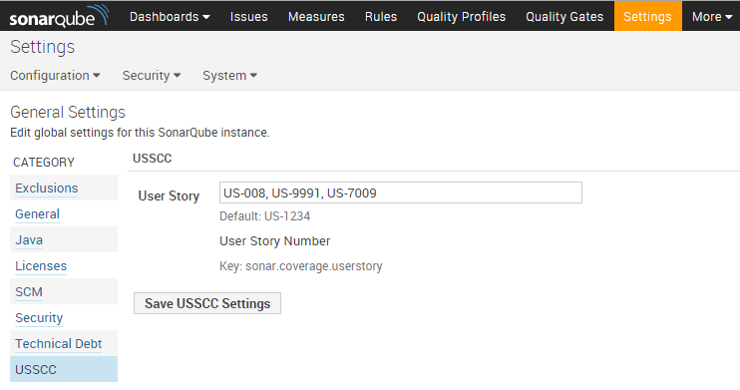
USSCC Plugin – Configure Plugin

Slide 10
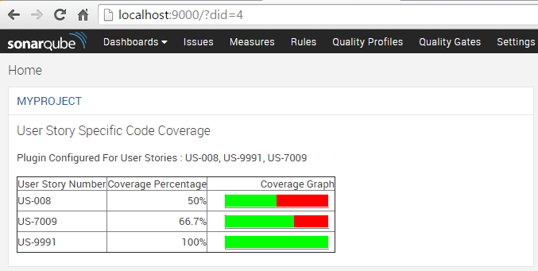
USSCC Plugin – Dashboard Widget

Slide 11
Tools Capability
Tool is currently supporting “SVN”,“Git” & IBM Clearcase code repositories.
It is interface driven, can be further extended to support any SCM repository.
Available as Sonar Plugin & Standalone Program.

Slide 12
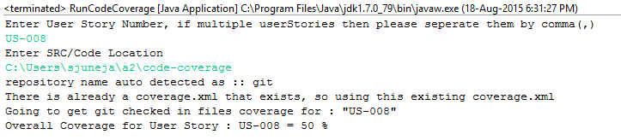
Standalone Program Screenshot

Slide 13
Contributions By
Chetan Kalanki
Saurabh Juneja
Manish Maker
Akshay Jain
Pallavi Garg

Slide 14
Thank You!

